Slide 1
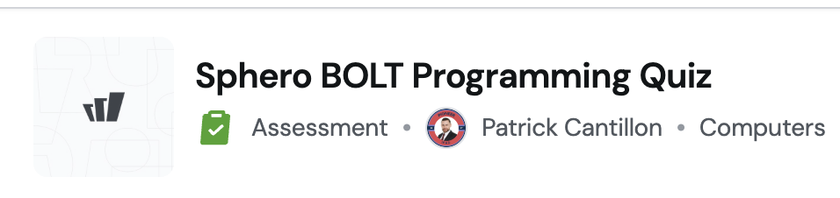
I didn't do this lesson yesterday i did this instead on the local editor.
I still did the quiz below -FYI Last 5 questions are about this lesson so edit out if don’t do lesson
https://wayground.com/admin/assessment/68e2420ce6de177e9a54c222?source=lesson_share

Slide 2


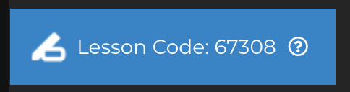
Hot BOLTato Game

Slide 3
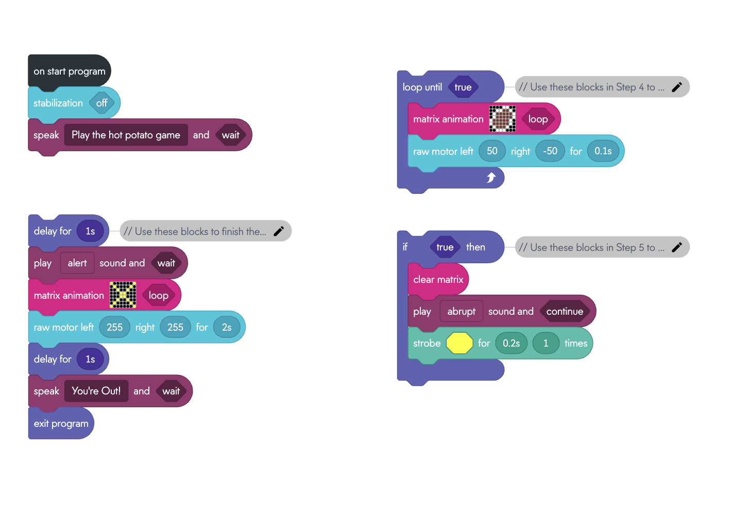
Starter Pack
Notes:
This is the project you will start with has combination of all the concepts with be using

Slide 4
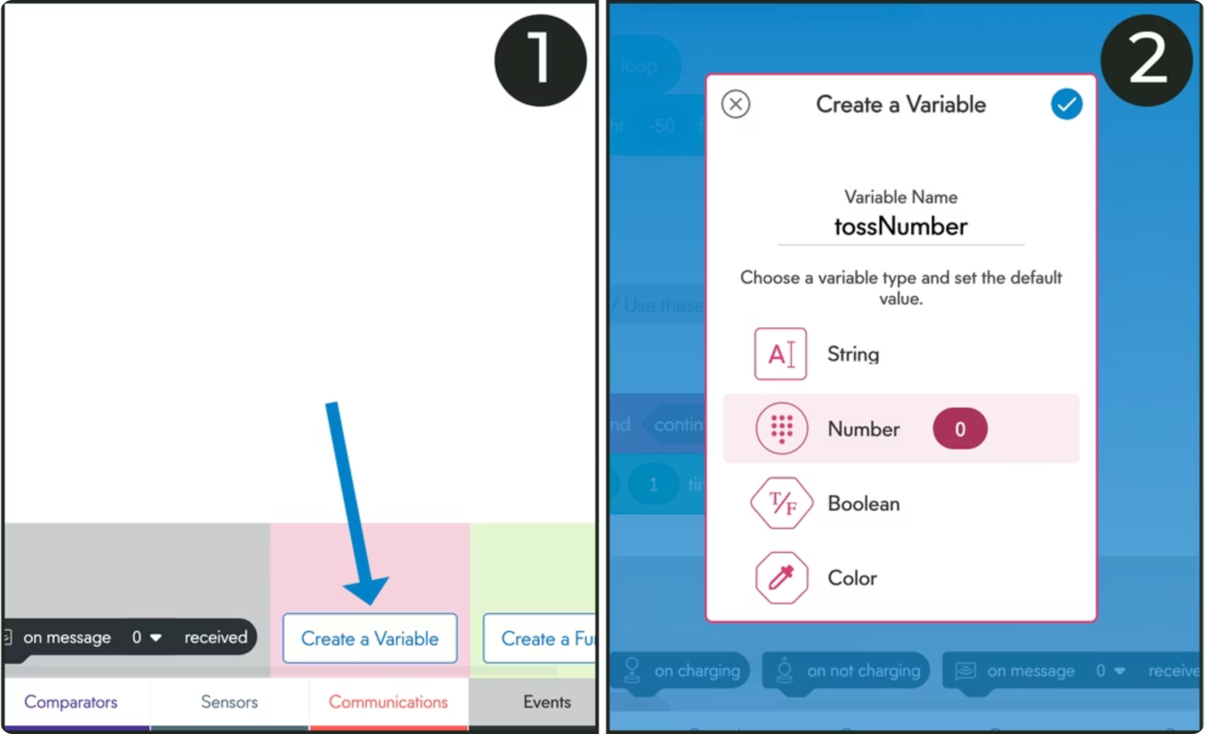
Creating Variables
Number Variables
Hold numeric values like counts and calculations
tossNumber tracks tosses
expireNumber sets elimination point

Slide 5
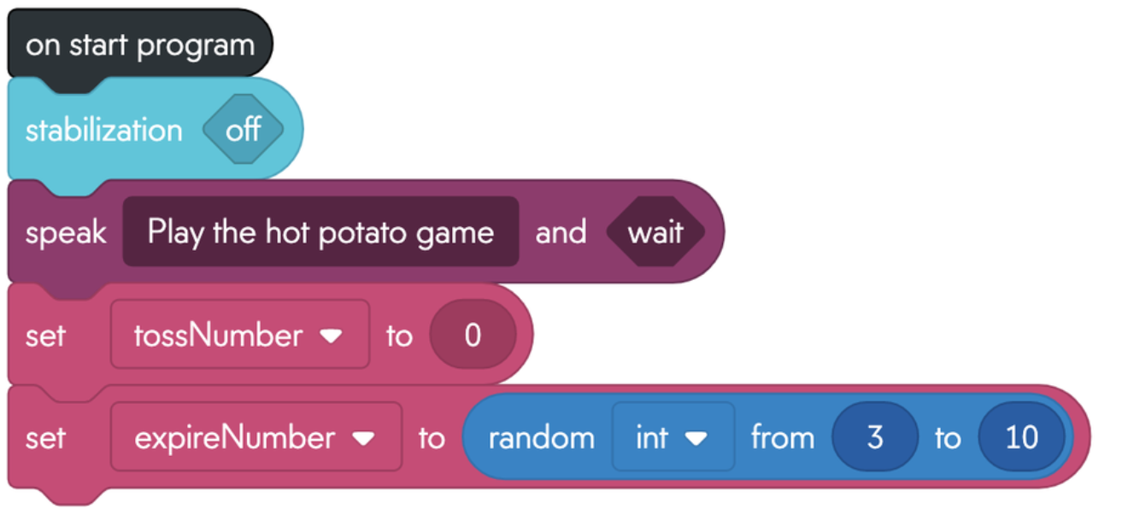
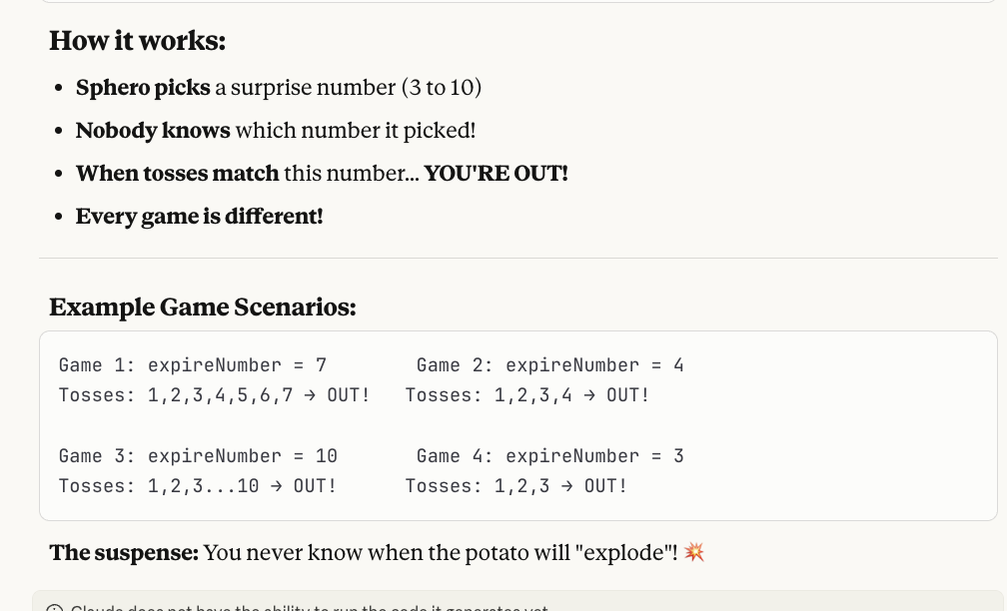
Setting up Variables

Slide 6
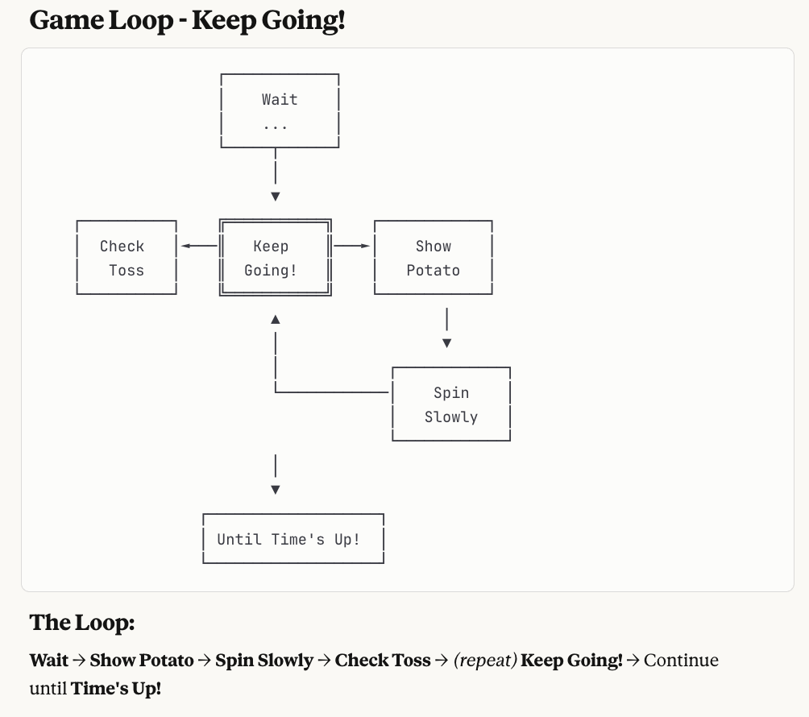
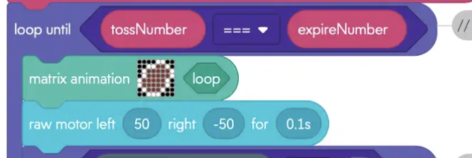
Using Loop Until
Notes:
A loop makes BOLT repeat actions
Show potato picture
Spin slowly
Check if tossed
Keep going UNTIL time's up!

Slide 7
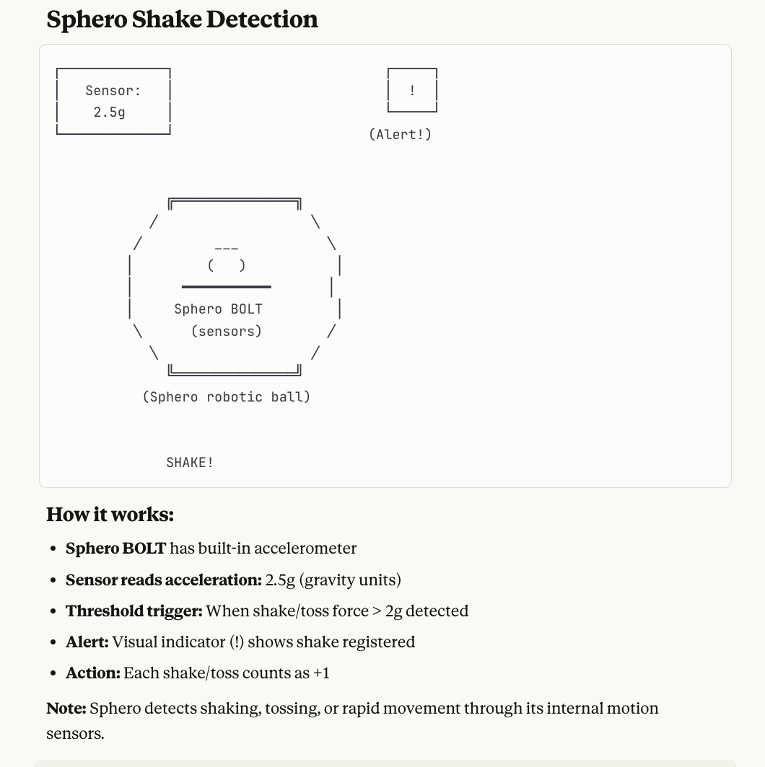
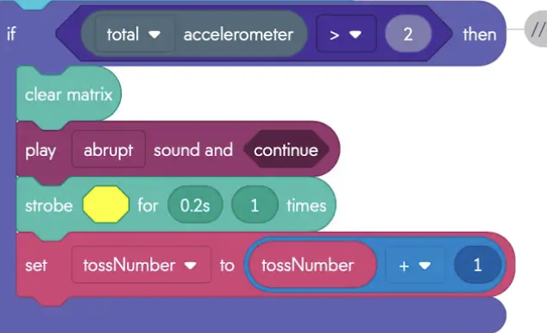
Using Sensors
Notes:
BOLT has a special sensor inside
It feels when you shake or toss it
Normal = 1 (sitting still)
Tossed = More than 2 (moving fast!)

Slide 8
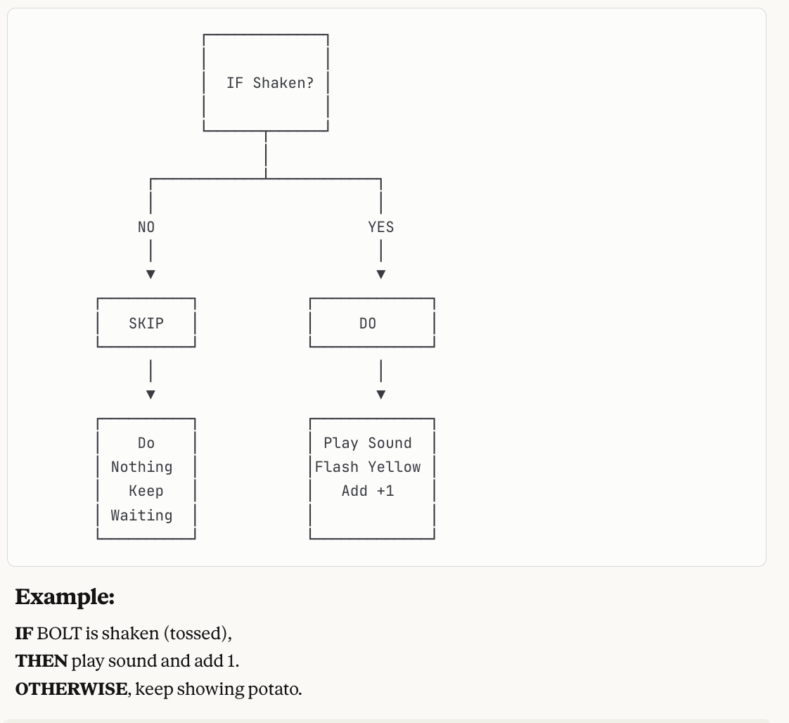
If-Then Decisions

Slide 9
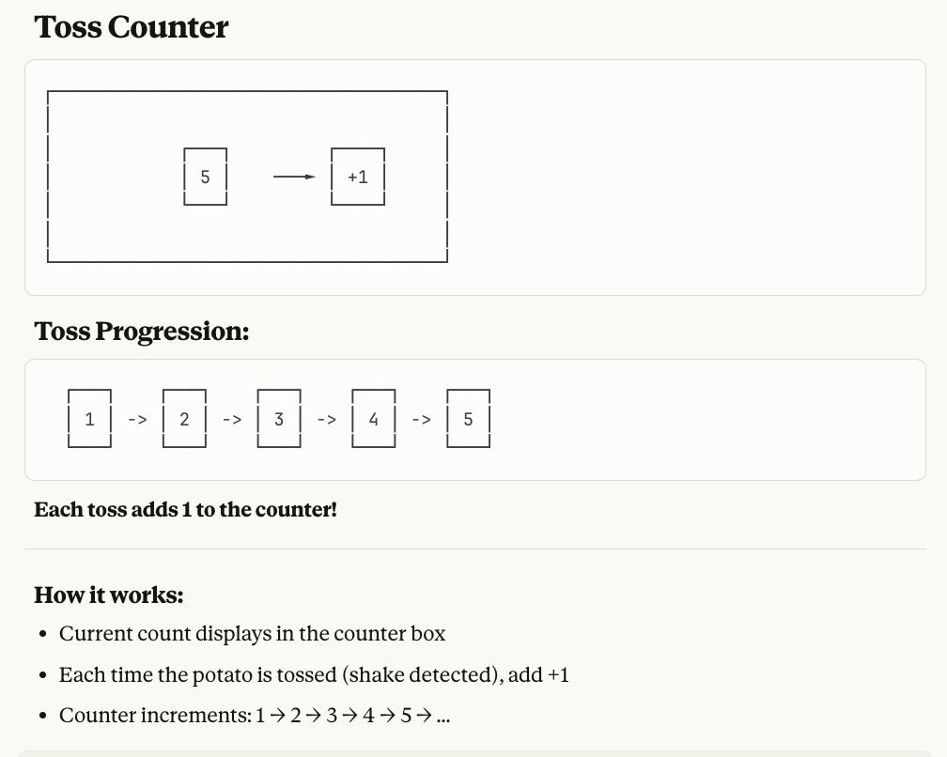
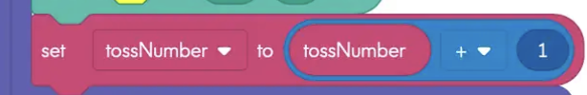
Counting Each Toss

Slide 10
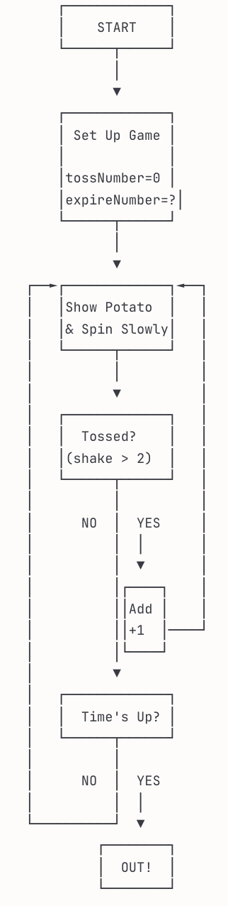
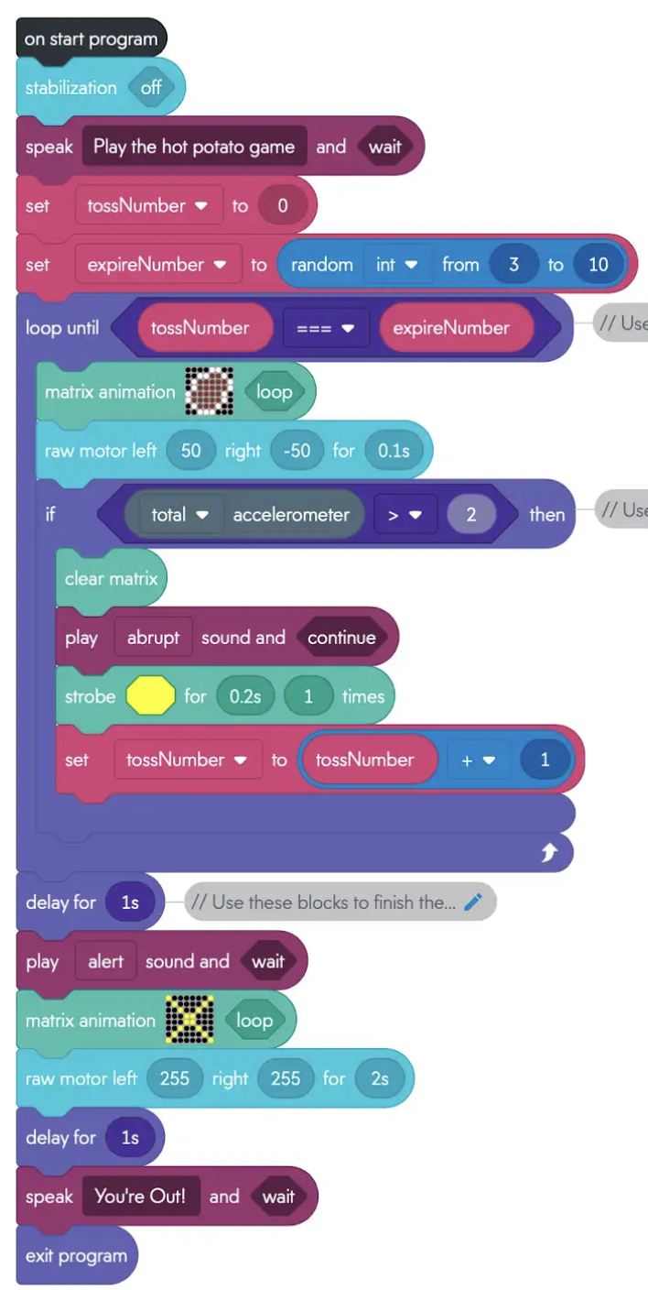
How the Game Works
Notes:
Start: Set up memory boxes
Loop: Show potato and check for tosses
If tossed: Add 1 to counter
Check: Is counter = secret number?
If YES: Game Over! You're OUT!

Slide 11
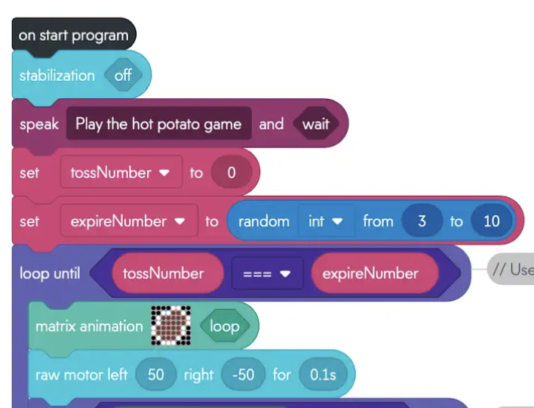
Building Your Game - Part 1
Create two variables
Set tossNumber to 0
Set expireNumber to random (3-10)
Start the loop!
Inside loop: Show potato animation

Slide 12
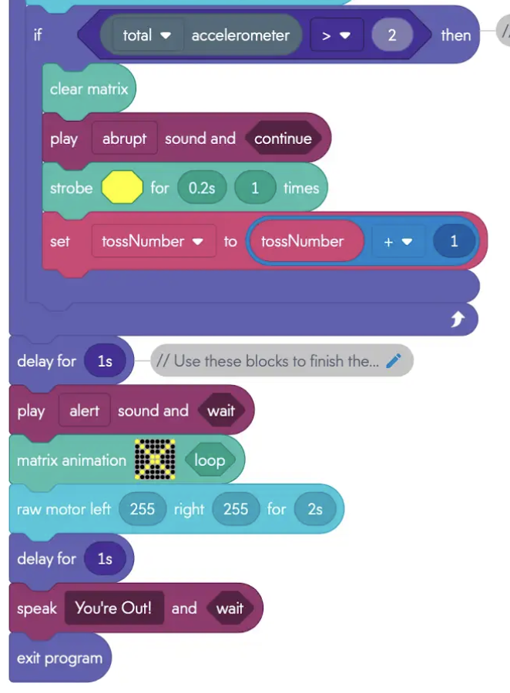
Building Your Game - Part 2
Check if accelerometer > 2 (g)
If tossed: Play sound, flash, add +1
Check if tossNumber = expireNumber
If equal: Exit loop and show "OUT!"

Slide 13
Make It Your Own!
Change the sounds and colors
Make it spin faster or slower
Change the random number range (1-20?)
Add a countdown timer
Create your own potato drawing!

Slide 14
What We Learned Today!
Variables: Memory boxes that hold numbers
Loops: Repeat actions until something happens
Sensors: BOLT can feel movement
If-Then: Make decisions in code
Random Numbers: Surprise every time

